Slide 1

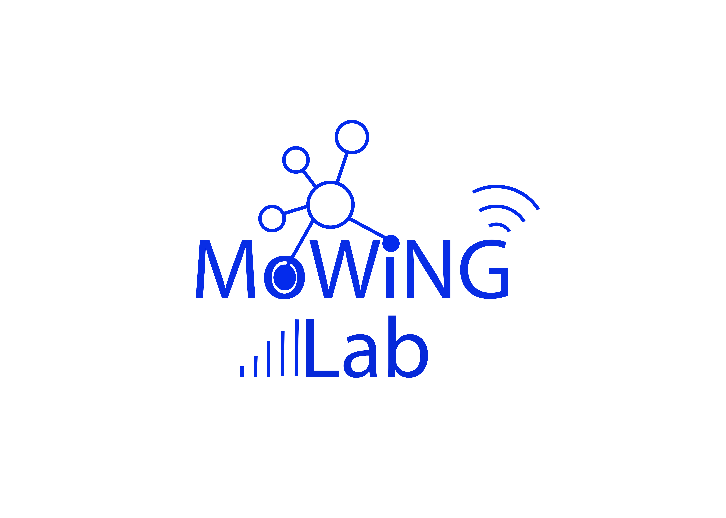
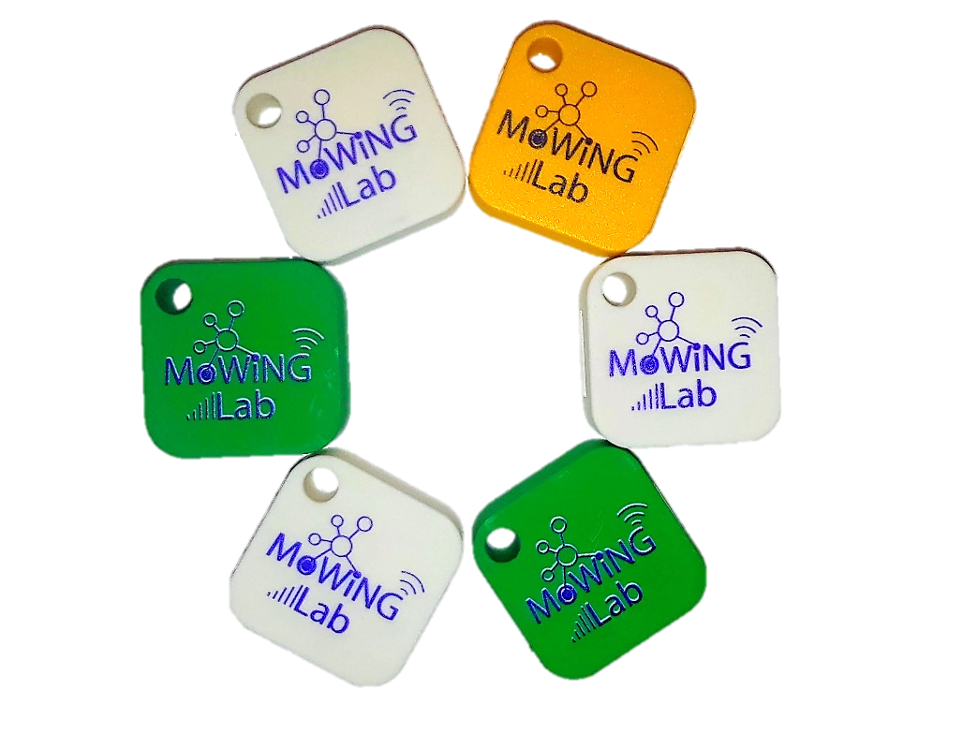
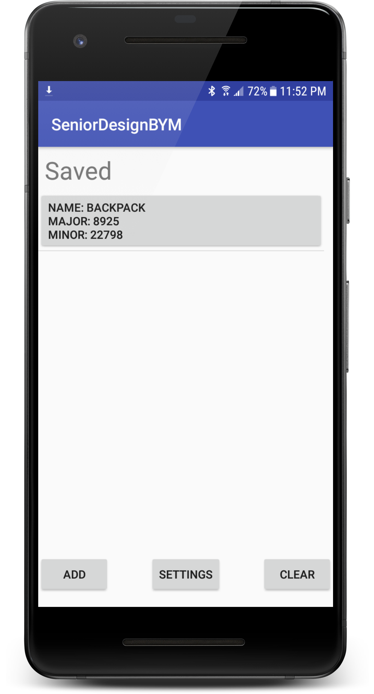
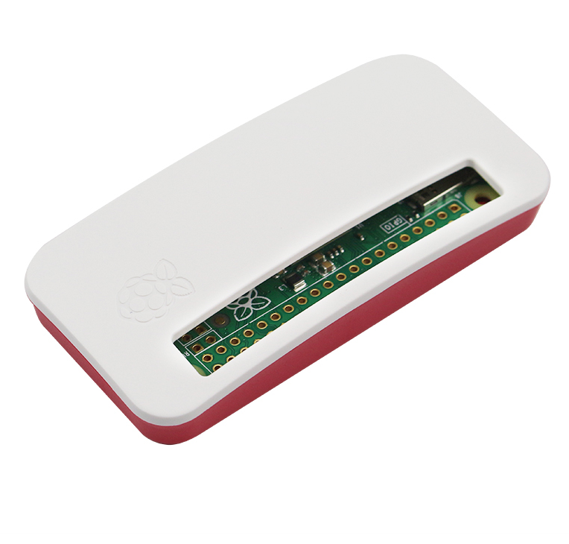
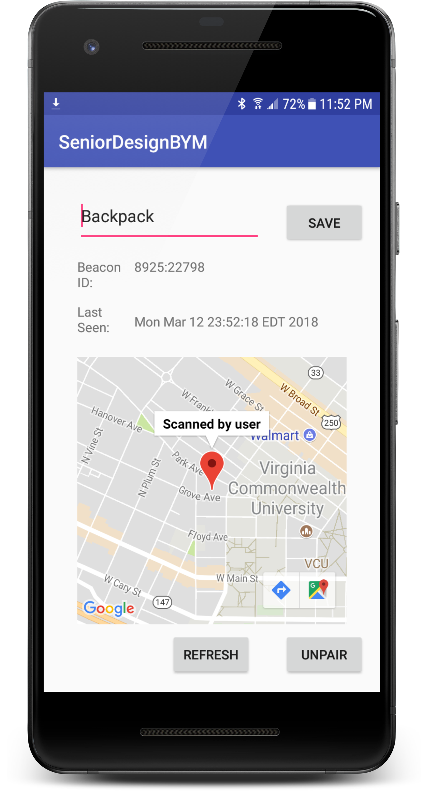






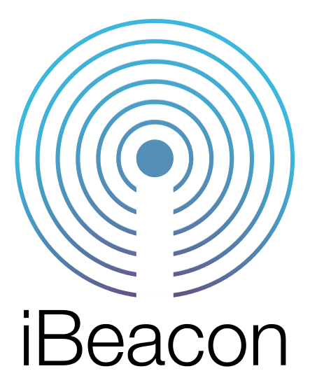

317
Campus Bluetooth Tag Network
Team members: Nicholas Bennett, Jordan Mays-Rowland, Justin Yirka | Faculty adviser: Eyuphan Bulut, Ph.D. | Mentor: Eyuphan Bulut, Ph.D.
Bluetooth Low Energy (BLE) tags
Custom ordered
Attachable to user’s keys, bag, and more
Goals
Design an open-source alternative to commercial item-tracking products such as Tile and TrackR, which use Bluetooth Low Energy (BLE) tags to track and locate lost items.
Develop both an Android and iOS app in parallel.
Customize the system to the needs of university and corporate campuses.
Partner with the VCU Police Department to address the needs of campus security departments.
Prioritize security and privacy of users, offering a more transparent product than most commercial alternatives.
Improvements over current commercial products
Crowd density: We implement a CrowdGPS strategy, turning every device in our network into a lost item locator. By promoting our system to users in the same geographic area, we achieve better item location.
Customization to campus with fixed scanners: GPS can be imprecise and unreliable, especially indoors. We improve item location by installing fixed scanners in key locations around campus, marking buildings, floors, and even rooms. The fixed scanners were implemented using inexpensive Raspberry Pi computers.
Partnership with campus police: One of the most common complaints to campus police is regarding lost or stolen property. Our product will help reduce these complaints. And, potential extensions exist for analyzing the data generated by campus users.
Security and privacy: Our app is open-source and so is more accountable to users than most alternatives.
Branding: Universities and other customers can distribute customized tags, promoting both their brand and campus safety.
Passive, anonymous scanning
Any device on network can automatically report observations of a user’s tag
Fixed scanners
Implemented with Raspberry Pis
Locations customized to campus to provide precise observations, even inside buildings
Tag Owner
Able to recover lost items
Access to a tag’s information is restricted to its owner
Beta Test
Using funds from the Mark A. Sternheimer Senior Design Award, we purchased 80 tags and conducted a small beta test with students on campus.
User feedback from the beta test was used to identify bugs, improve usability of the interface, and plan future features.
Load testing by increasing the number of beta testers helped identify improvements to our database design.
Knowledge gained from the test, as well as the code we produced, may be used in future research projects.
Cloud
Implemented using Google Firebase
Realtime database & backend processing
Developed with:

